Slide 1
STANDARD COSTING
A PRIMER

Slide 2
One of the prime functions of management accounting is to facilitate managerial control and the important aspect of managerial control is cost control.
Standard costing is one of the most important tools, which helps the management to plan and control cost of business operations

Slide 3
Under standard costing, all costs are pre-determined;
pre determined costs are then compared with the actual costs;
The difference between pre-determined costs and the actual costs is known as variance;
which is analyzed and investigated to the reasons;
The variances are then reported to management for taking remedial steps;
So that the actual costs adhere to pre-determined costs.

Slide 4
Meaning of Standard Cost
Standard costs are predetermined cost which is used as a yardstick ;
to measure the efficiency with which actual costs has been incurred under a specified circumstance.
For Example the amount of raw material needed to produce a unit of product can be determined and the cost of that raw material is estimated. This is termed as standard material input and if there is any difference in the quantity or cost of raw material then it is said variance.

Slide 5
Meaning of Standard Cost
i) Pre-determined cost: Standard cost is always determined in advance and before of actual point of time of incurring of costs.
ii) Based on technical estimates: Standard cost is determined only on the basis of a technical estimate and on a rational basis.
iii) For the purpose of Comparison: The very purpose of standard cost is to assist in the comparison with actual costs.

Slide 6
Meaning of Standard Costing
Standard costing is a technique;
Used for determining the standard cost of a product or service;
Applying them to know the variation between actual and standard cost;
And analyzing the reasons of variations so that maximum possible cost efficiency could be ensured.

Slide 7
Process of Standard Costing
SC involves the following steps:
i) Determining the standard cost for various elements of cost.
ii) Knowing the actual cost
iii) Comparing the actual cost and standard cost and knowing the variance
iv) Variance analysis to know the reasons of variance
v) Reporting the variance to the concerned management for taking suitable actions.

Slide 8
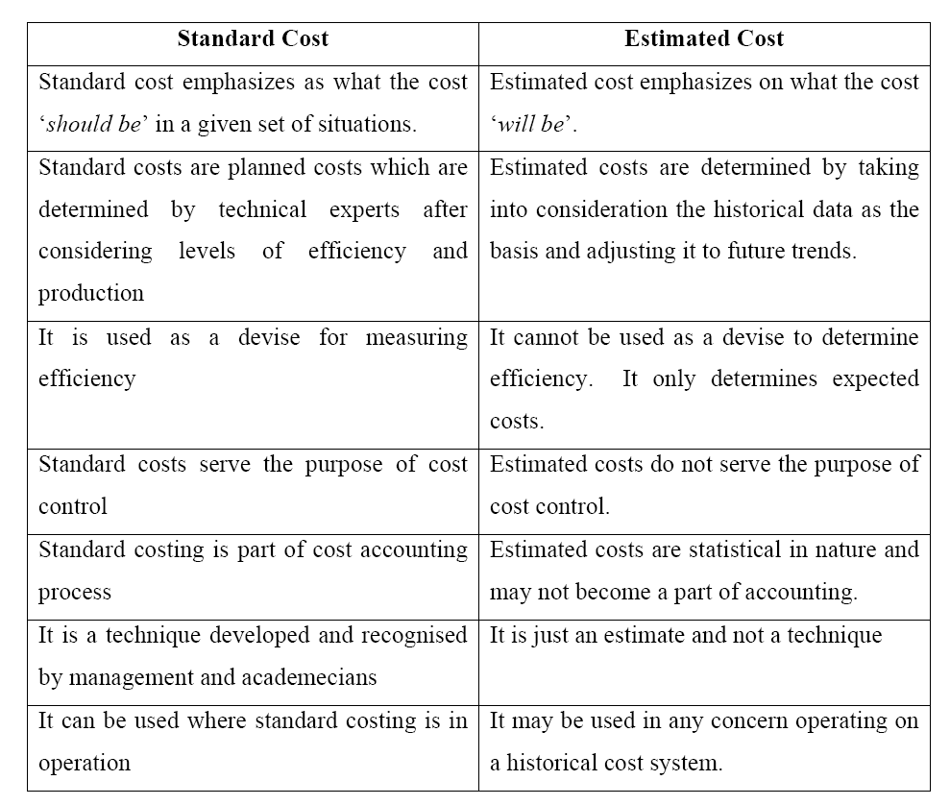
Difference between SC & EC

Slide 9
Advantage of Standard Costing
SC helps in measuring efficiency – Standard Costs provide a yardstick against which actual costs can be measured
Standard costing is helpful in determining prices - It also helps to find out the prices of various products.
SC is helpful in cost control : By comparing actual costs with the standard costs, variances are determined. Variance analysis facilitate management to locate inefficiencies and to take remedial.

Slide 10
Advantage of Standard Costing
Management by exception - In MBE each individual is fixed targets and every one is expected to achieve that. Management need not supervise each and everything and need not bother if everything is going as per the targets. Management interferes only when there is deviation.
Cost consciousness
Provides incentives : Many times schemes are formulated to reward those who achieve targets. Which leads to increase in efficiency, productivity and morale of the employees.

Slide 11
Limitations of Standard Costing
Setting right standard is difficult.
Not suitable to small business
Difficult to fix responsibility - Responsibility can be fixed only in the case of controllable variances. It is difficult to classify controllable and uncontrollable variances.
Technological changes: Standard costing may not be suitable to those industries which are subject to frequent technological changes. In the case of change in the technology, production process will require a revision of standard.

